Slide 1
Konnected
Synchronizing Android Users

Slide 2





No Synchronization!
Why get Konnected?

Slide 3
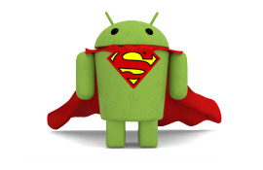
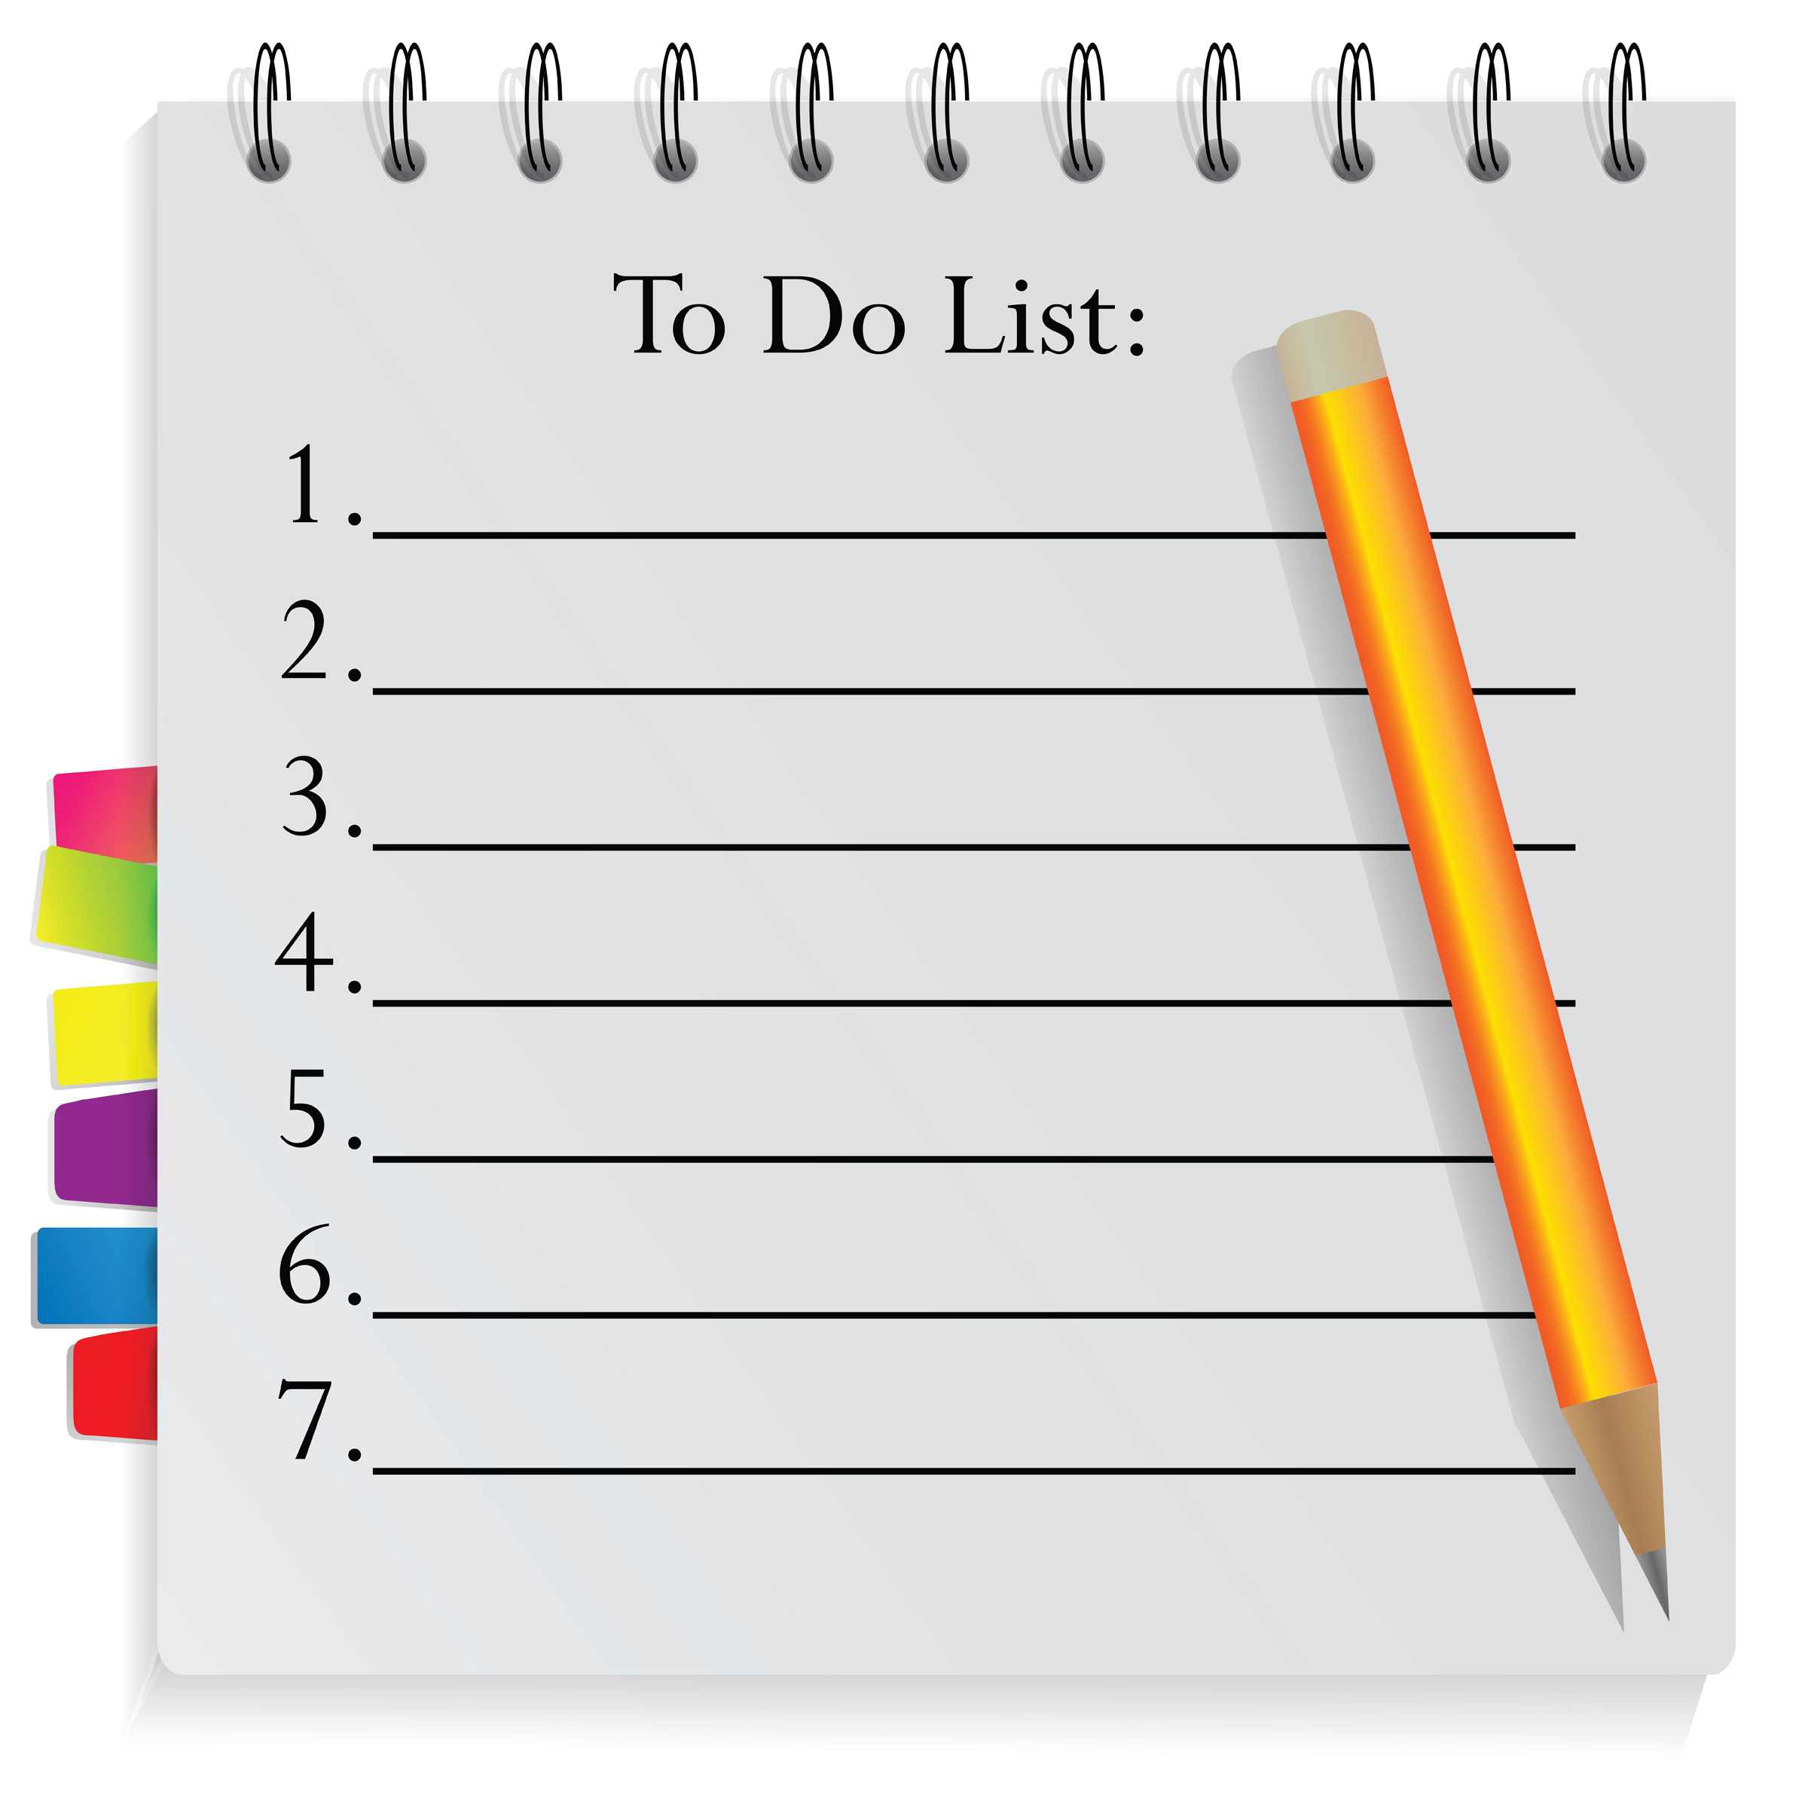
Can Technology help?
How about a Shared To-Do List…
Who can view it?
Who can update it?
What to do first?
Task status?
Task location?

Slide 4





Approach
Add or Do Task
Add Task
Do Task

Slide 5
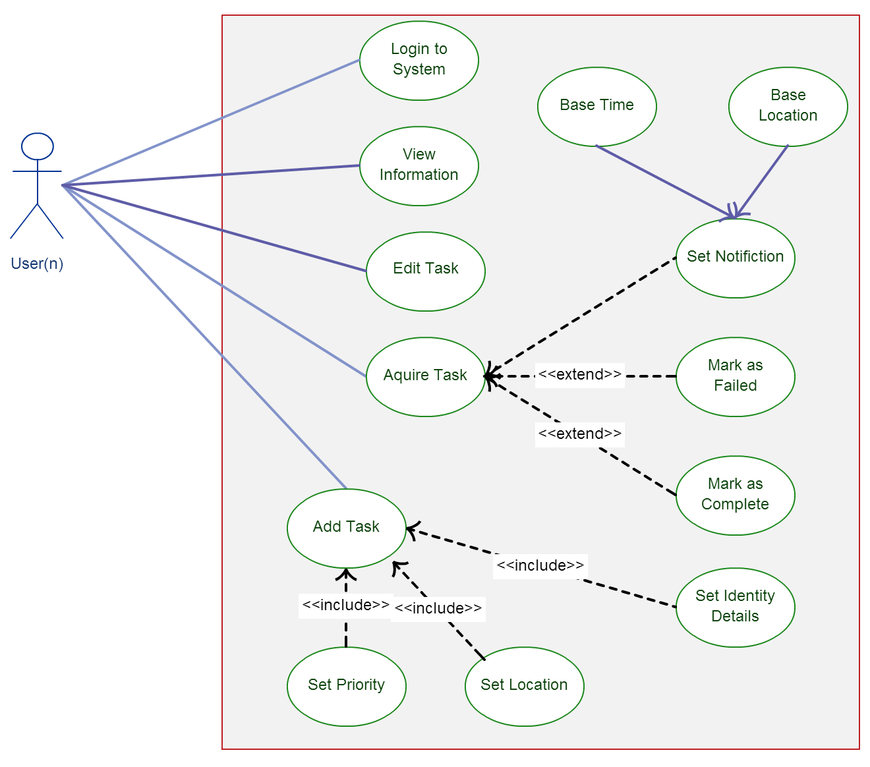
Functionality
What a user can do
Register/Login/Logout
Add a task
Identity, Priority, Location
Edit or update a task
Acquire/Release a task
Mark as complete
Notifications
Use case view of a normal user

Slide 6
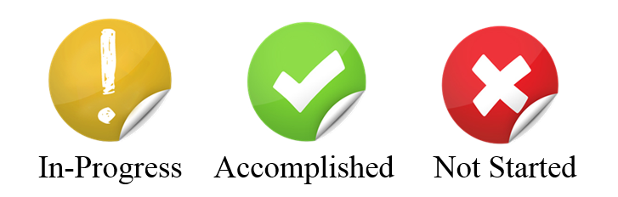

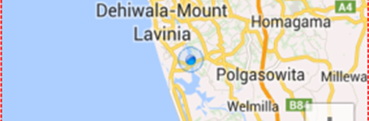
Features
Different Icons for showing Task Status
5 star rating system to prioritize tasks
A google map to mark and view the location of a task

Slide 7
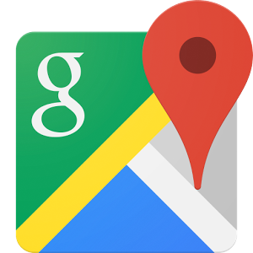
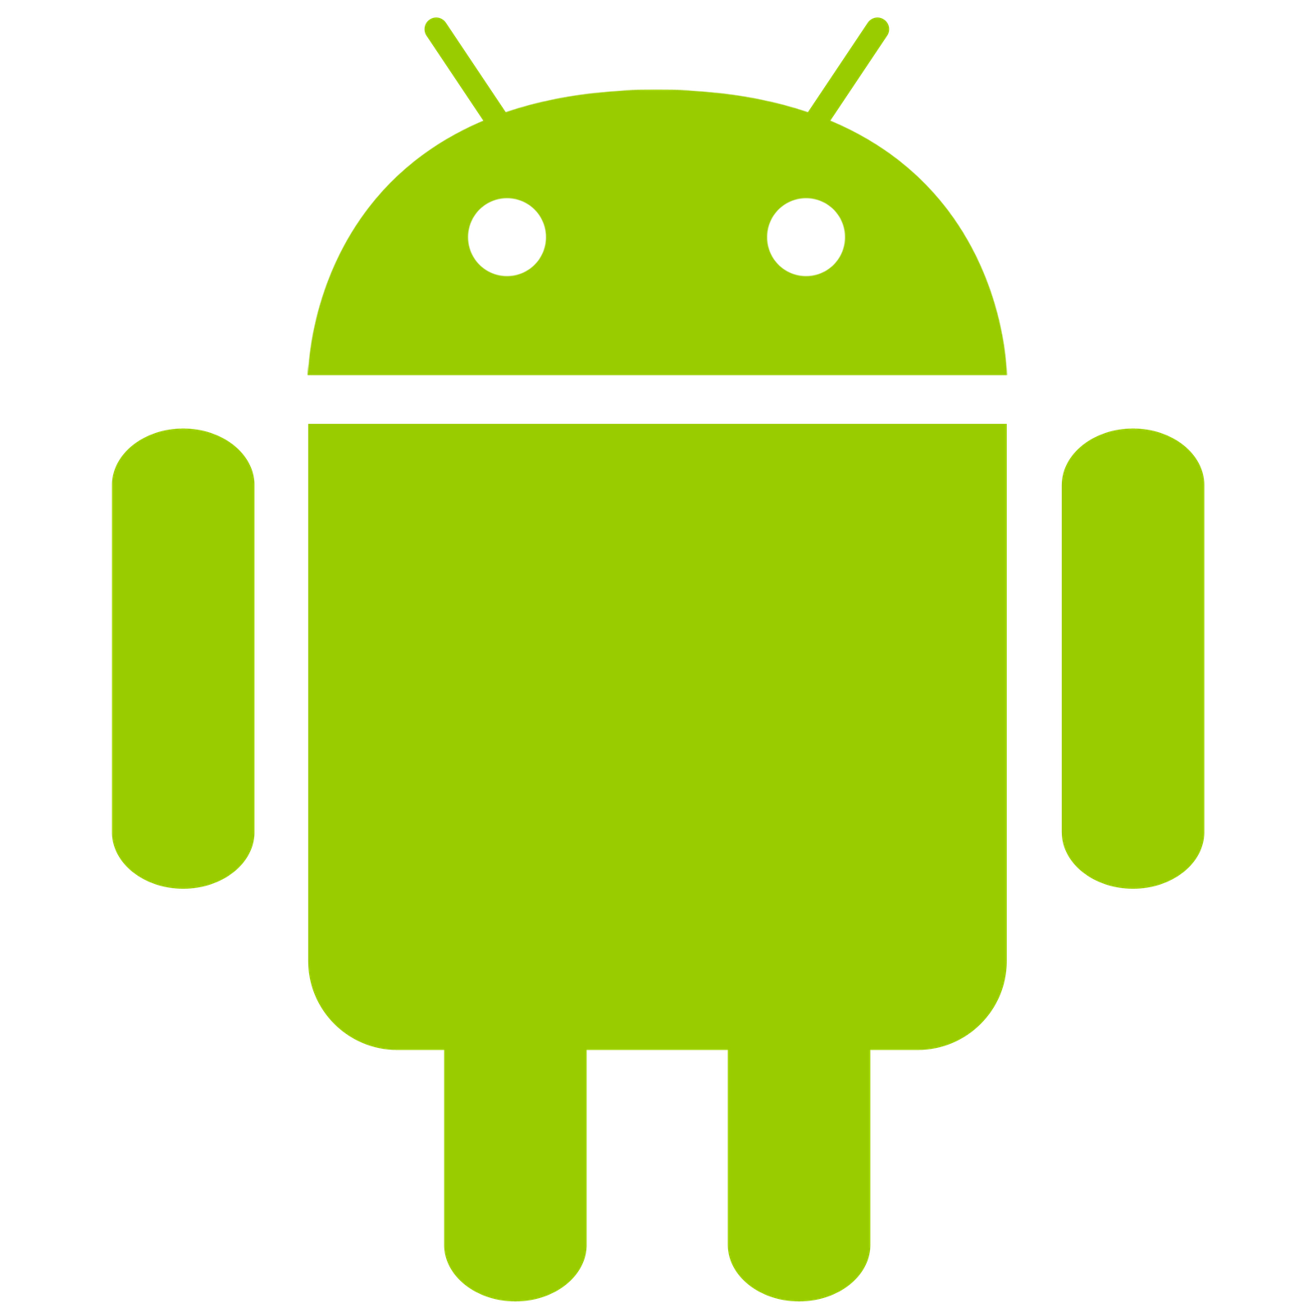

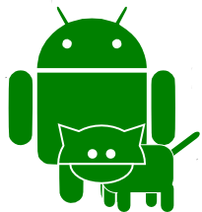


Implementation and Testing
Tools and Technologies
Android / Java / Eclipse / Google Maps API
Testing
Unit testing
Automated testing with Robotium Solo
Beta testing
Manual Testing using the LOGCAT

Slide 8
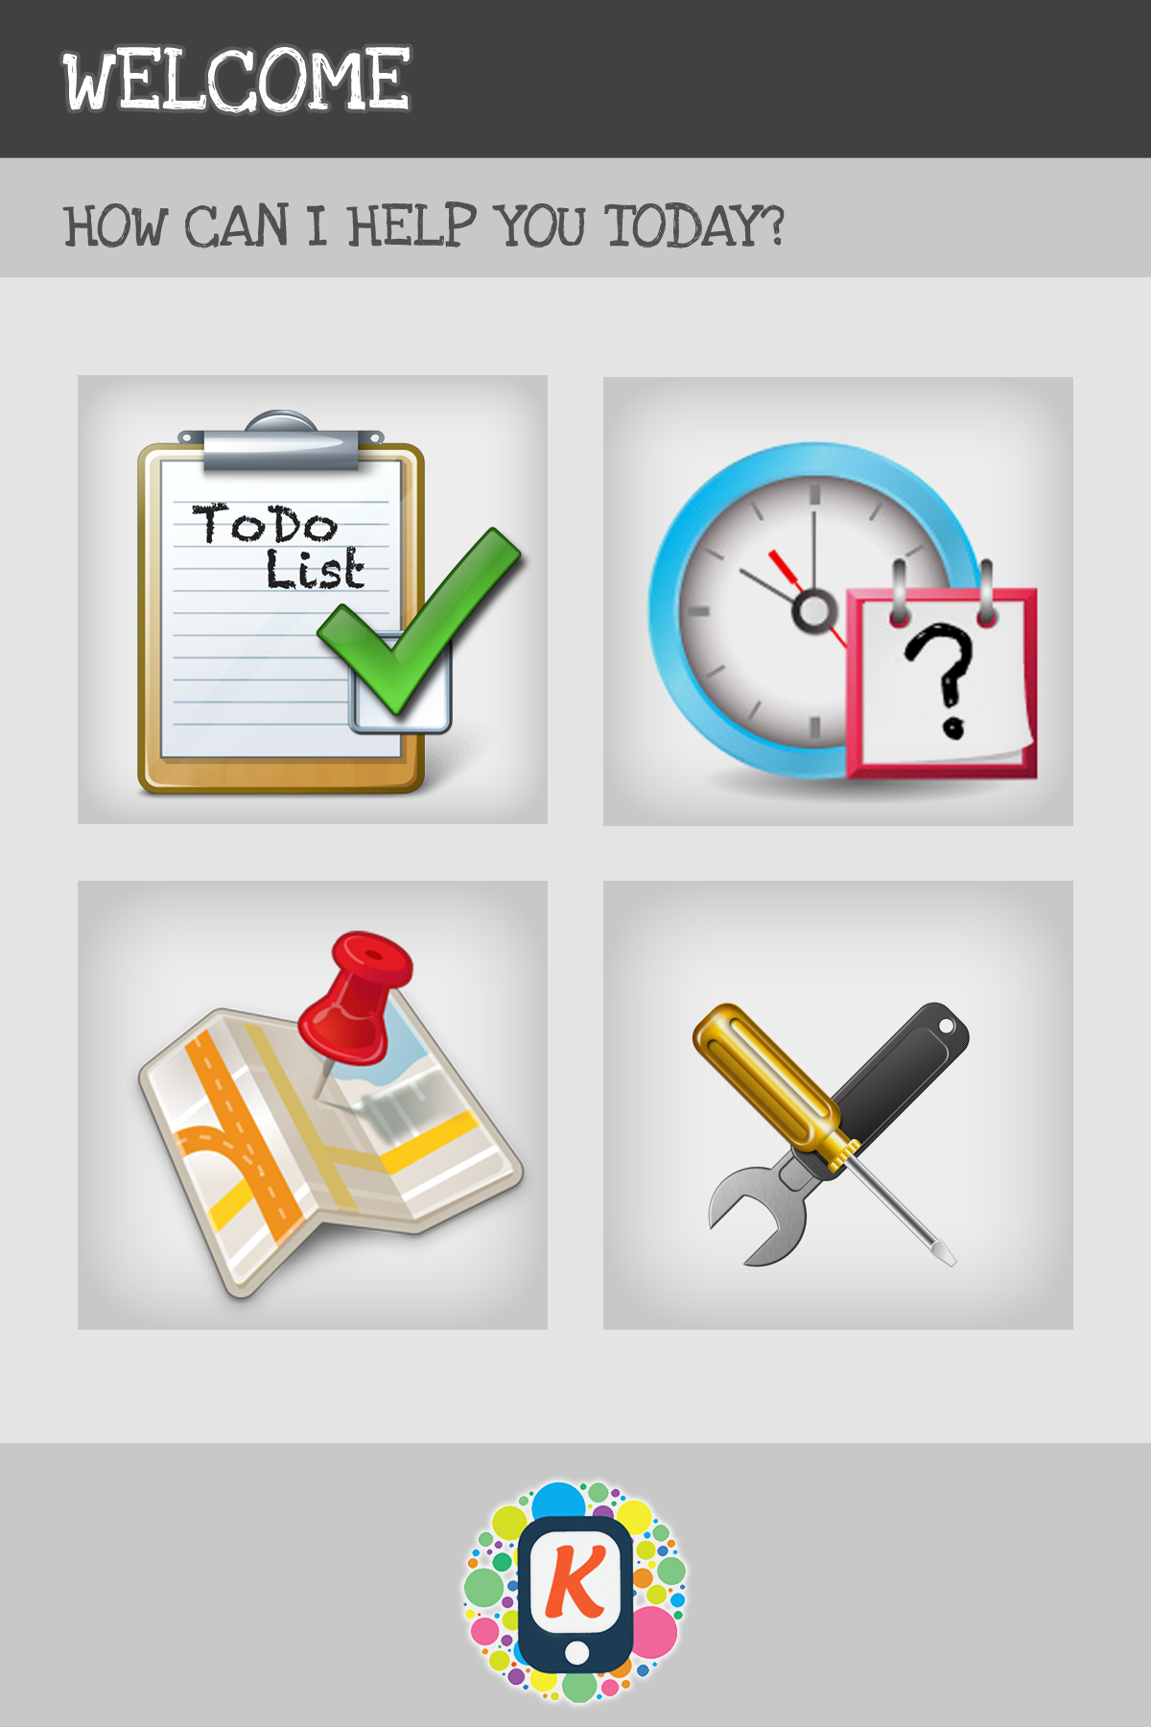
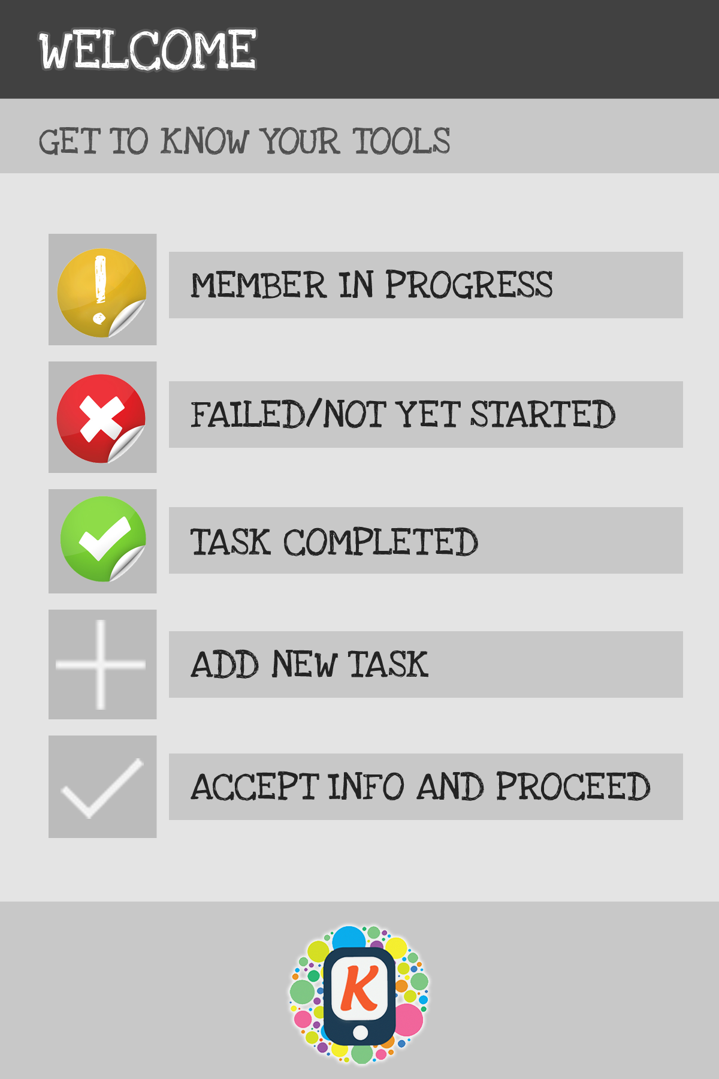
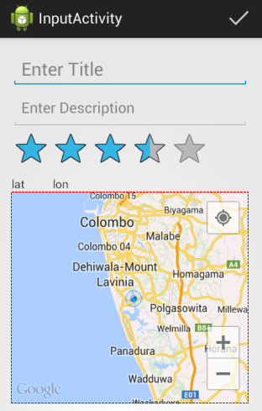
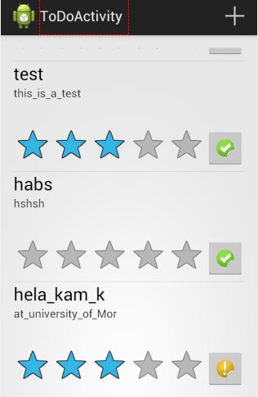
Samples
Man Menu
Help
Add New Task
View Tasks

Slide 9

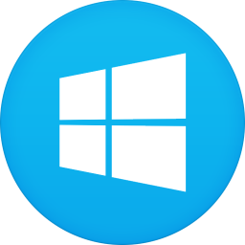
What’s More…
Shared database…???....Where are we heading?

Slide 10
Future Work
Implementations for iPhone and Windows Phone
Concurrency control
A more robust Notification System
Comments
Rating the completed Tasks

Slide 11
Thank You

